Slide 1


Public Health & Adult Protective Services:
A Partnership Supporting
Vulnerable Community Members
June 15th, 2026
Tyson Hungerford &
Mary Friedman

Slide 2


Many of the patient’s we encounter have needs that extend beyond emergency medical care:
Aging in place
Cognitive decline
Self-neglect
Unsafe living conditions
Social isolation
Refusal of needed services
Caregiver concerns
Notes:
Commentary should include – As mandatory reporters we (fire service) have been good at detecting and reporting the obvious issues of abuse, exploitation, or suspected violence. We have extended the education and perception to be more diligent about the rest of mandatory reporting to include developmentally disabled or chronically disable individuals lacking in resources, as well as the state definition of “frail or elderly individuals that cannot complete activities of daily living”.

Slide 3
Status of Unification Talks
Intersection of Public Health & Adult Protective Services
Public Health:
Shared Population:
APS:
Aging in place
Vulnerable adults
Self-neglect
Safety concerns
Cognitive decline
Voluntary engagement
Frequent utilizer work
Resource Navigation
Case management
Healthcare coordination
Protective Services
Investigations
Independent Assessment
Capacity Evaluation
Protective Interventions

Slide 4

Building a Culture of Mandatory Reporting
Our partnership began with re-education:
Video training
Mandatory reporting education
APS referral guidance
Scenario-based discussions
Ongoing station training
Notes:
We want crews to understand not only when to call APS, but why APS is such an important partner. Make sure to point out that we included the supervisors of Arapahoe and Douglas County APS in the video training, in order to capture the perspecti

Slide 5

From Awareness to Action
APS referrals by year:
2023 – tracked via Smart Sheets Occurrence Reports – 36
  Conducted training and education last quarter of 2023
2024 – Our ability to track started mid-year through Julota - 74
2025 – 139
2026 – Currently, 54
Notes:
Once crews better understood the process and that APS was not punitive, referrals increased significantly:
Increase in crew confidence.
Earlier identification of concerns helps navigate frequent utilizers earlier – more opportunities for intervention before crisis.
Improved coordination between Public Health and APS.

Slide 6
What Collaboration Looks Like
911 Response:
EMS Response
Patient Encounter
Crews Identify Concern:
Self-neglect
Cognitive Concerns
Suspected Abuse
APS Referral:
Crew Made Report
APS Notified
APS Assessment:
Independent Evaluation
Protective Services Considered
Public Health Follow Up:
Resource Navigation
Healthcare Coordination
Improved Safety Outcomes:
Increased Supports
Reduced Crisis Utilization
Notes:
The referral for the crews is not the end of the process, but rather the beginning of the collaborative intervention.

Slide 7
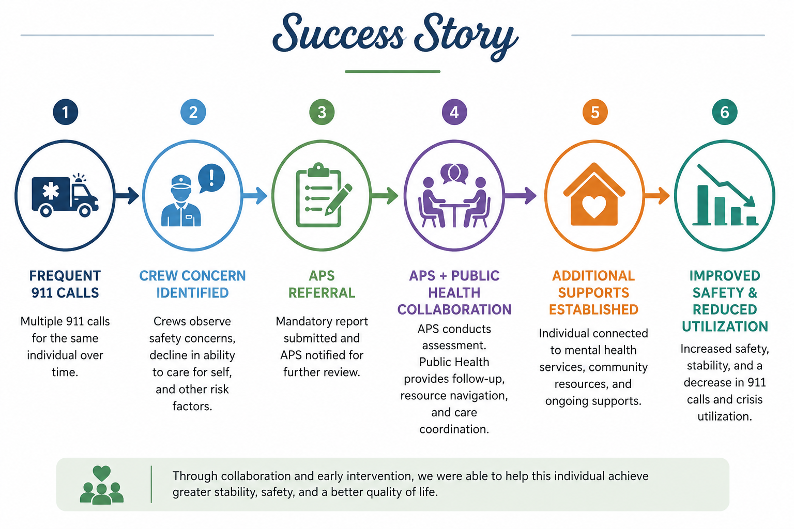
Shared Partnership Success
Notes:
Keep this part narrative and human

Slide 8
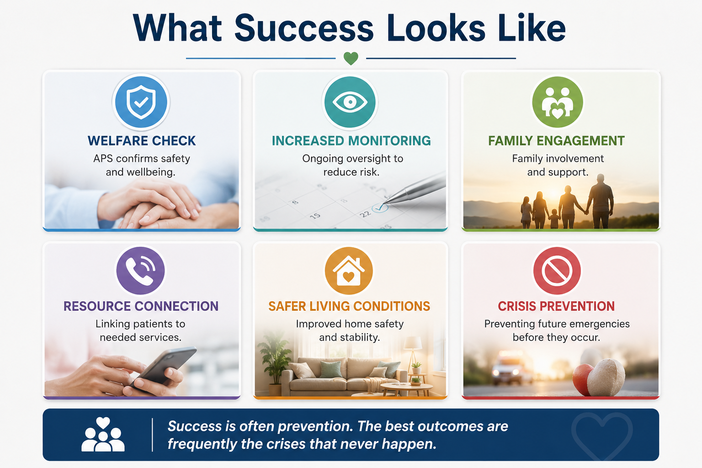
Beyond the Referral
Notes:
Success is often prevention. The best outcomes are frequently the crises that never happen.

Slide 9
Thank You
Notes:
Give thanks to Arapahoe County APS for hosting us and being able to share a piece of their work with our board and community members. Thank APS as well for being collaborative partners with Public Health.

