Slide 1


South Metro Fire Rescue
Facilities Updates – Board of Directors
June 1, 2026

Slide 2
Facility Overview
2026 Project updates
Construction
  Project status
Design
  Project status
Fleet/Logistics New build
  Project status

Slide 3
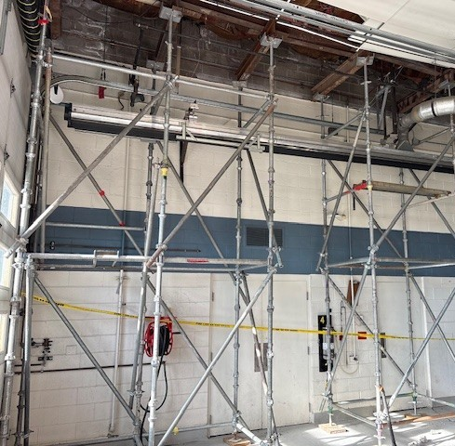
Station 41 – Construction - Structural Repair
5/8/26 Bid
Palace Construction
$101,795.09
5/18/26 Board Approved Contract
6/3/26 Construction Pre-Construction Meeting

Slide 4
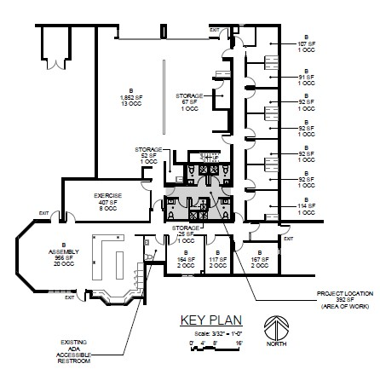
Station 23 - Construction - Bathroom Reno
Out to Bid
Pre-Bid Conference
6/11/26
Bid Opening
7/2/26

Slide 5
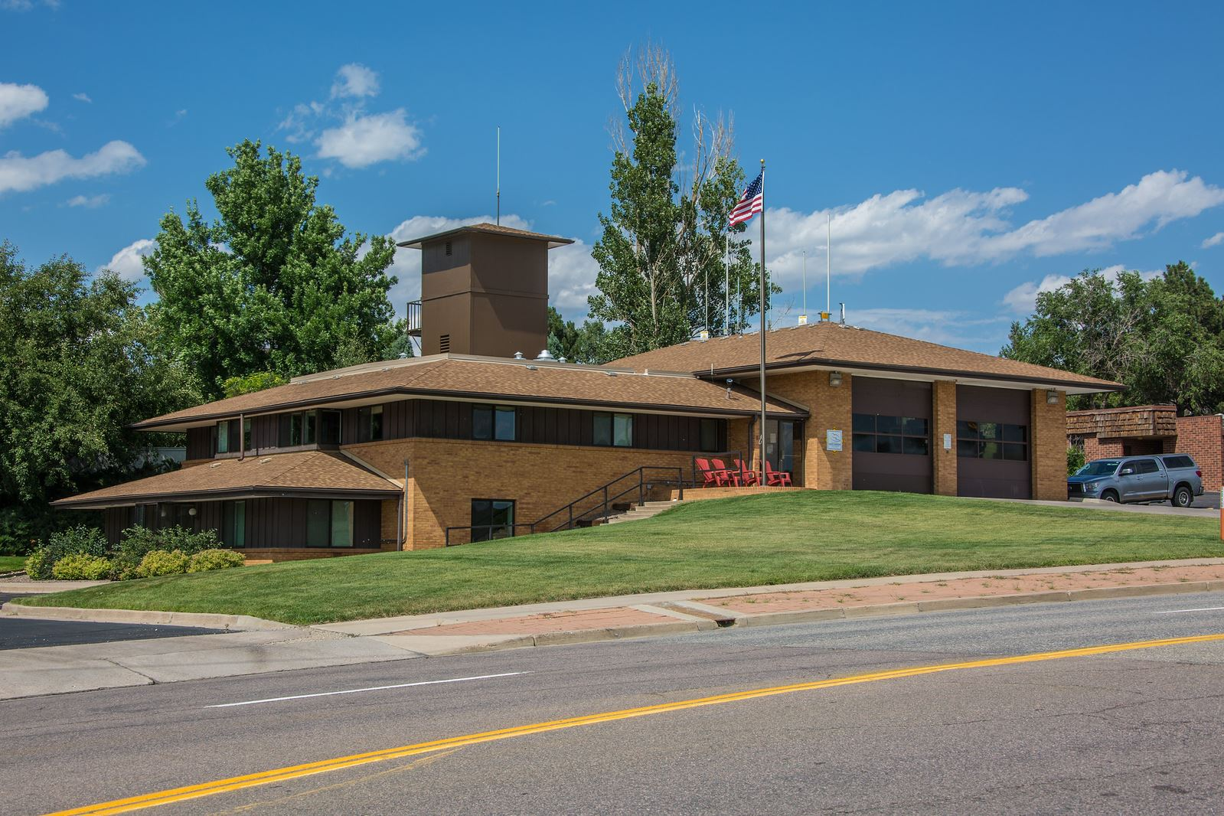
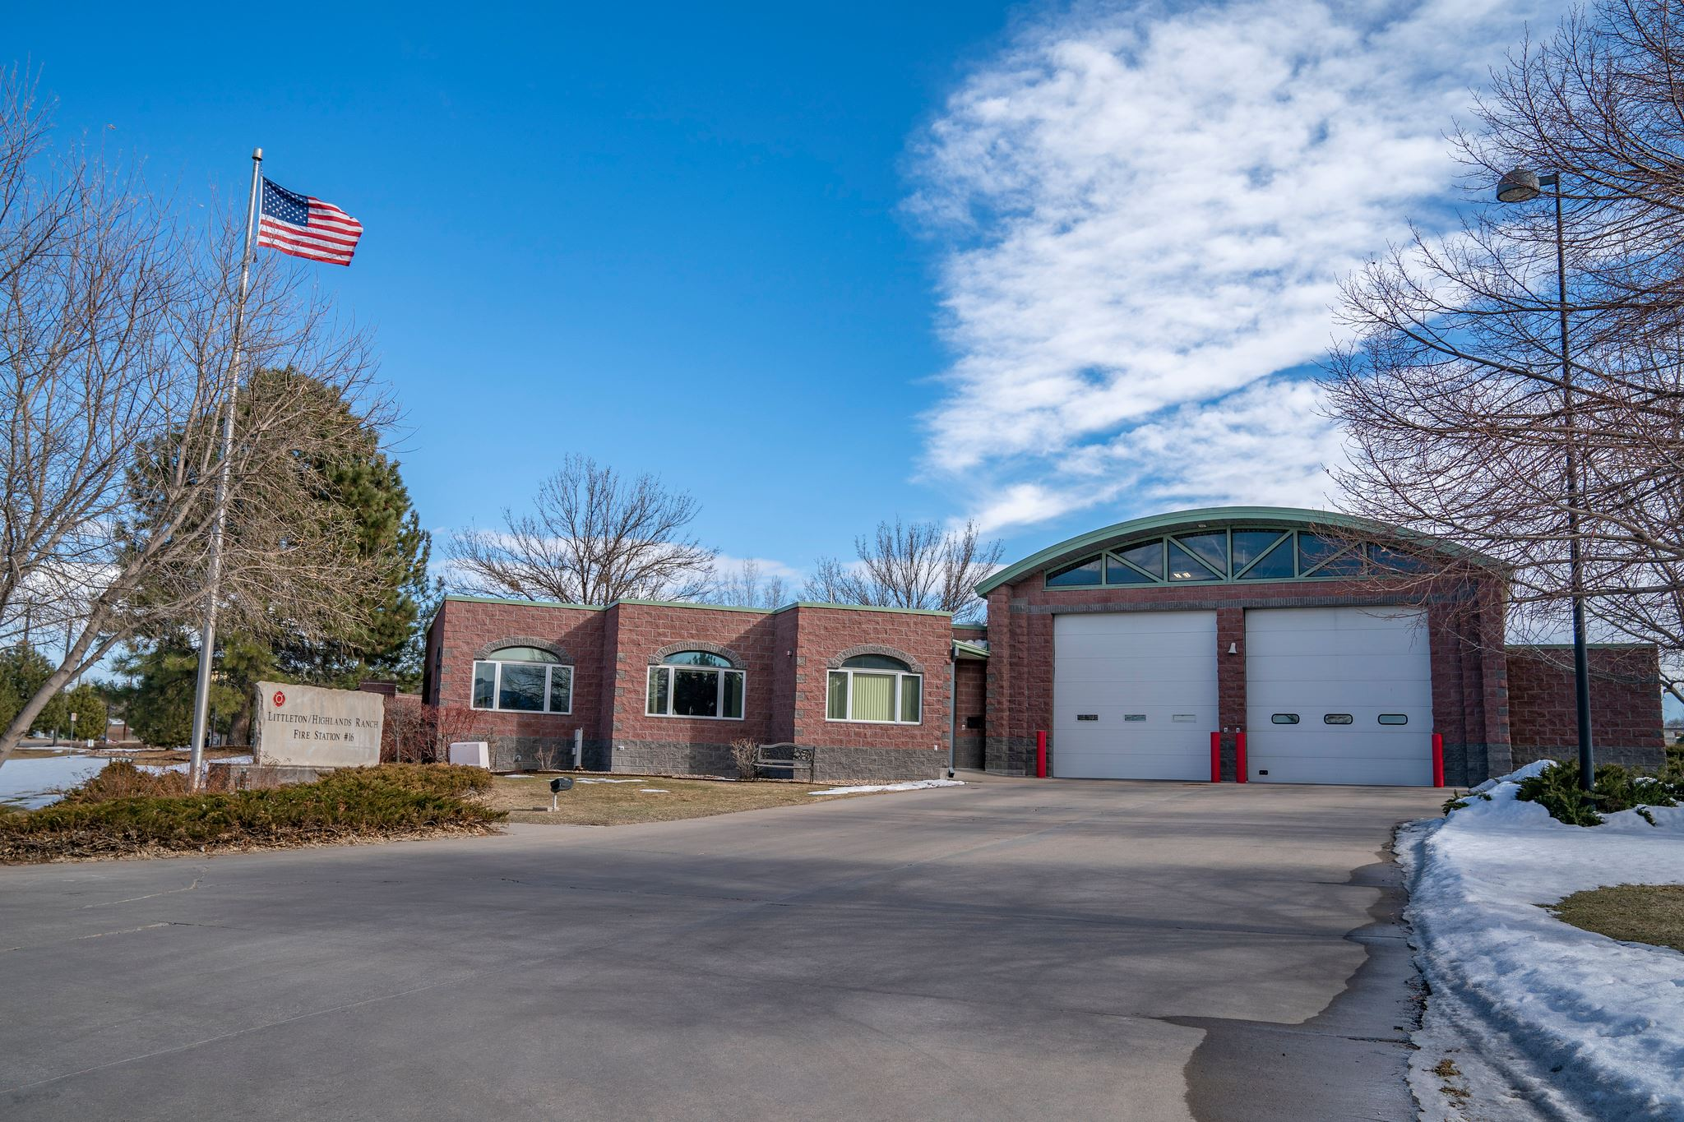
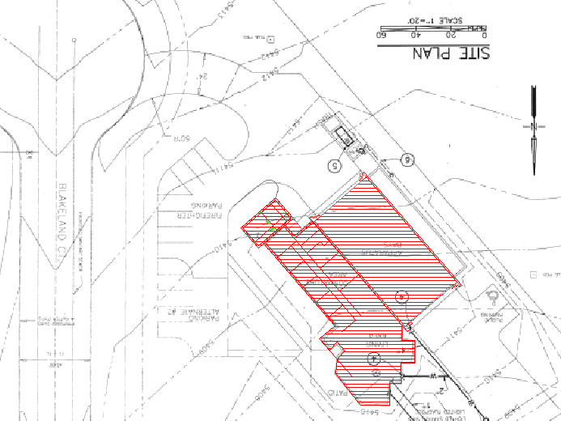


Station 33 & 16
Consultant Selection
Notes:
Needs assessment with operations and crews. Evaluate the architectural programming based history and lessons learned 15, 20, 32, 31.
Go out to bid for architect. Evaluate build approach.

Slide 6
Consultant Selection
DESIGN
Qualifications-Based Procurement
The Brooks Act 1972, U.S. federal legislation established Qualifications-Based Selection (QBS) as the standard procurement process for architectural and engineering (A&E) services for public construction projects
Consultant Selection:
Notify 4-5 Consultants to submit a Qualifications Packet Related to the Project.
An Evaluation Team will conduct Interviews and Score each Consultant Team.
A Selection is made from the evaluation results.
Notes:
Berry to begin needs assessment with operations and current personal. Begin design work.

Slide 7
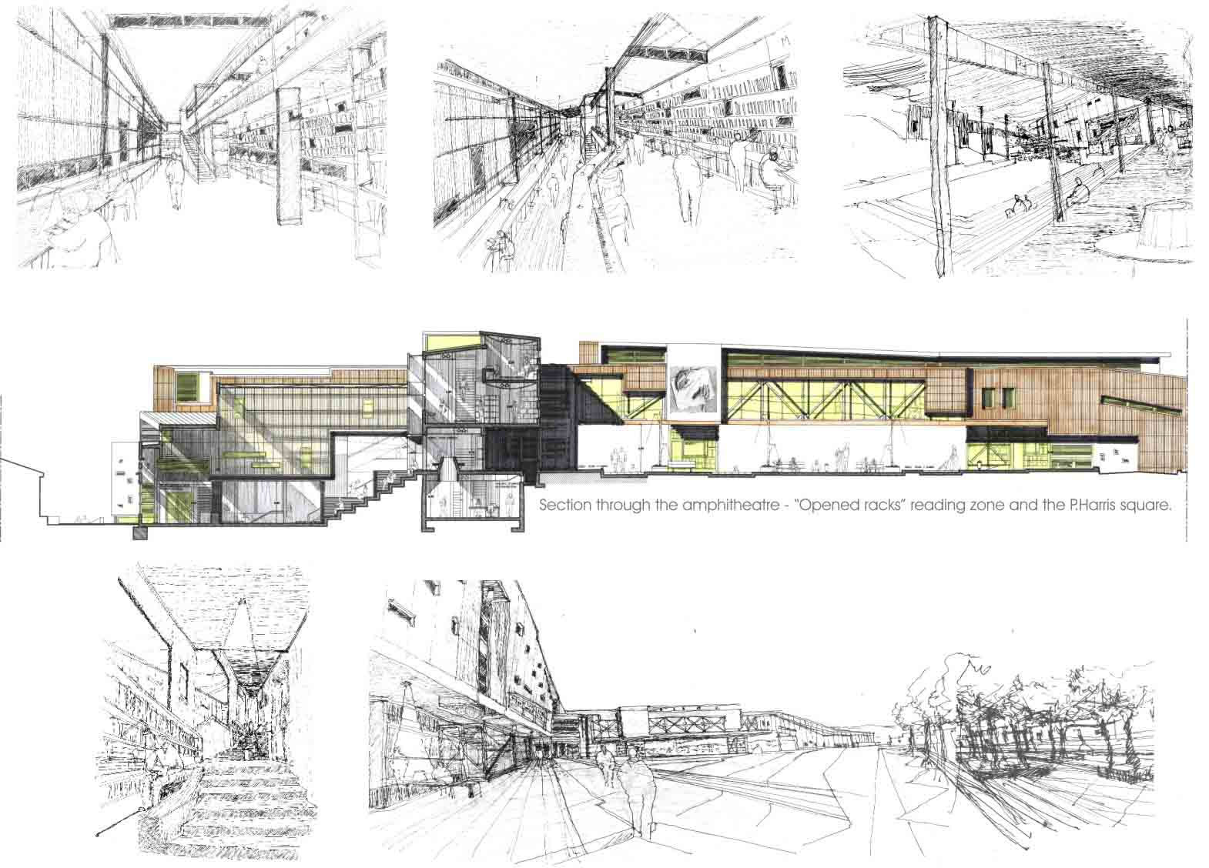
Station 33 & 16 – Schematic Design
DESIGN COMMITTEE
Design Committee: Comprised of Consultant, SMFR Staff plus others as desired.
The Design Committee is instrumental in developing the Schematic Design.
SMFR and Consultant consult on recommendation for the Contract Delivery Method.
Notes:
Needs assessment with operations and crews. Evaluate the architectural programming based history and lessons learned 15, 20, 32, 31.
Go out to bid for architect. Evaluate build approach.

Slide 8
Contractor
Typical Delivery Methods
1. Design-Bid-Build (D-B-B) – All Size Projects
Process: Owner hires a design team (architect/engineer) first, then issues design documents for bid to contractors. The lowest bidder is typically selected.
Pros: Clear roles, well-understood process, easy to manage.
Cons: Sequential process can cause delays; owner bears most design risk.
2. Construction Manager / General Contractor (CMGC) – Complex Projects
Process: A CMGC contract is a strategic approach to construction project delivery that combines early contractor advisory services with a later construction role, fostering collaboration, cost control, and risk management throughout the project lifecycle.
Pros: Early Contractor involvement, better cost control, improved schedule planning, enhanced communication & risk mitigation.
Cons: Possible higher cost if scope changes, procurement is through RFP evaluation – takes longer, needs strong owner engagement in design decisions.
3. Design-Build (D-B) – All Size Projects
Process: Owner contracts a single firm that handles both design and construction.
Pros: Faster delivery, integrated team, better coordination.
Cons: Less design control for owner; single point of accountability.
Notes:
Berry to begin needs assessment with operations and current personal. Begin design work.

Slide 9
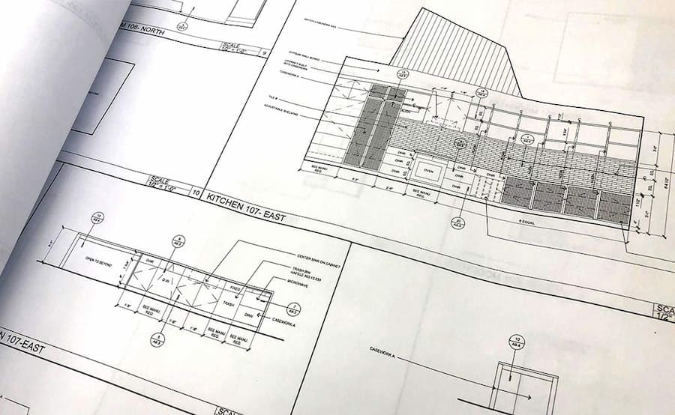
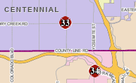
Station 33 & 16 – Design Development
DESIGN
The Consultant creates a Design Development Package.
The Consultant develops the cost opinion if DBB or the GC provides an estimate if CMGC.
This will help determine if modifications to the design are required to align with budget
Notes:
Needs assessment with operations and crews. Evaluate the architectural programming based history and lessons learned 15, 20, 32, 31.
Go out to bid for architect. Evaluate build approach.

Slide 10
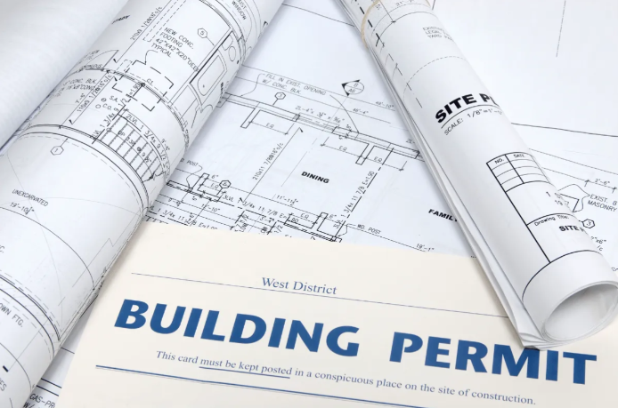
Station 33 & 16 – Construction Documents
Bid or GMP
The Consultant prepares the Construction Documents.
The Drawings, Specifications and the agreement make up the components of the legal contract.
These will be submitted for Permit.
Notes:
Needs assessment with operations and crews. Evaluate the architectural programming based history and lessons learned 15, 20, 32, 31.
Go out to bid for architect. Evaluate build approach.

Slide 11
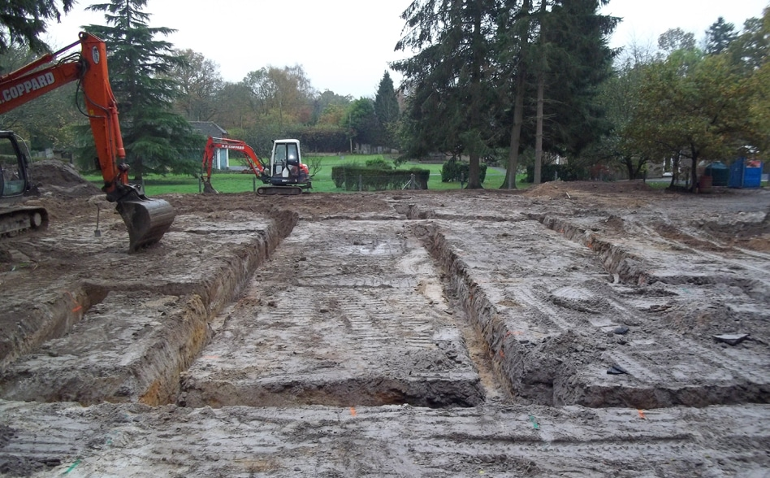
Station 33 & 16 – Construction Begins
Weekly OAC Meetings (Owner Architect Contractor)
In the DBB scenario a bid is received and a contract is issued to a General Contractor.
or
In the CMGC Scenario a GMP Change Order is added to the current CMGC contract.
NTP – Notice to Proceed is issued
Notes:
Needs assessment with operations and crews. Evaluate the architectural programming based history and lessons learned 15, 20, 32, 31.
Go out to bid for architect. Evaluate build approach.

Slide 12
Mineral Building Projects - Pre Design
    Conducting a general assessment of current and future space needs
      Security and access
      Shared space availability - conference and training rooms, outside group use
      Technology needs (Board room, conference rooms, training rooms)
      Department Operations Center needs – ability to support large or long-term incidents from Mineral
    Mineral Basement Phase 1 (Clinic/IT) in Process
    Mineral Basement Phase 2 (Dispatch)
    Replace Basement Training Rooms
    Evaluation of FBI lease renewal in Process

Slide 13
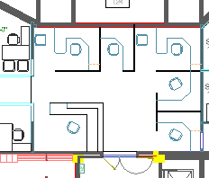
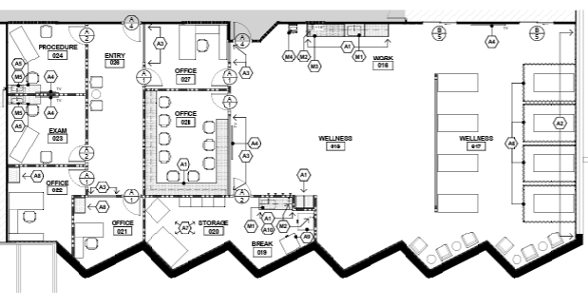
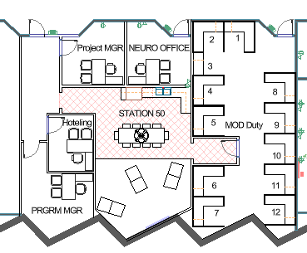
Mineral Building Projects - Fit Studies
    Mineral Basement Phase 1 (IT)
    Mineral Basement Phase 1 (Wellness)
    Mineral Basement Phase 1 (Clinic - Mod Duty – Station 50 Concept)

Slide 14
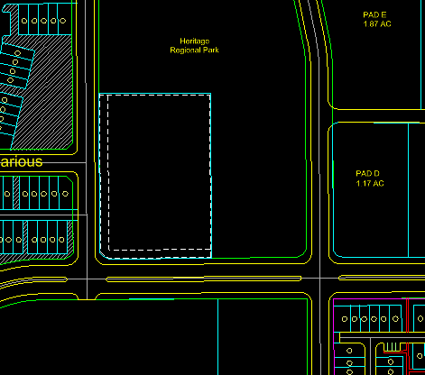
STERLING RANCH
Site: 2.17 Acres

Slide 15
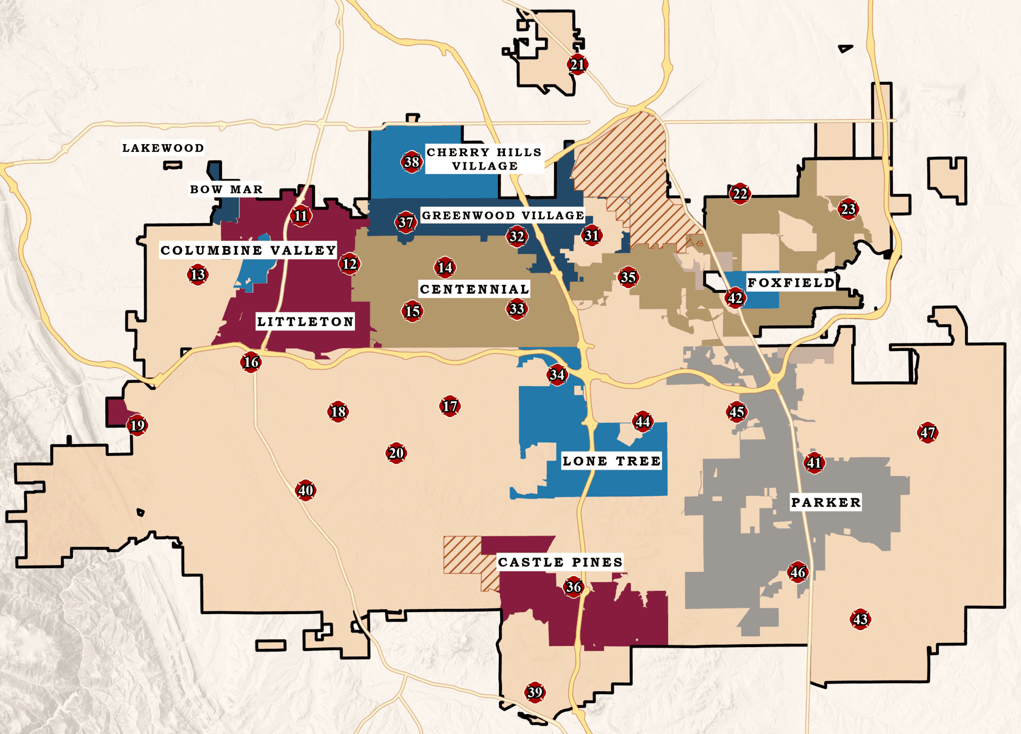
Fleet and Logistics Update
Completed partnership outreach
Proposals being Developed
  SMFR Evaluation Strategy
Notes:
Completed partnership outreach:
Completed Meetings:
Town of Parker
Douglas County Sherriff
Douglas County Schools
Arapahoe County

Slide 16
Current Sites
Notes:
Have met with both developers

Slide 17
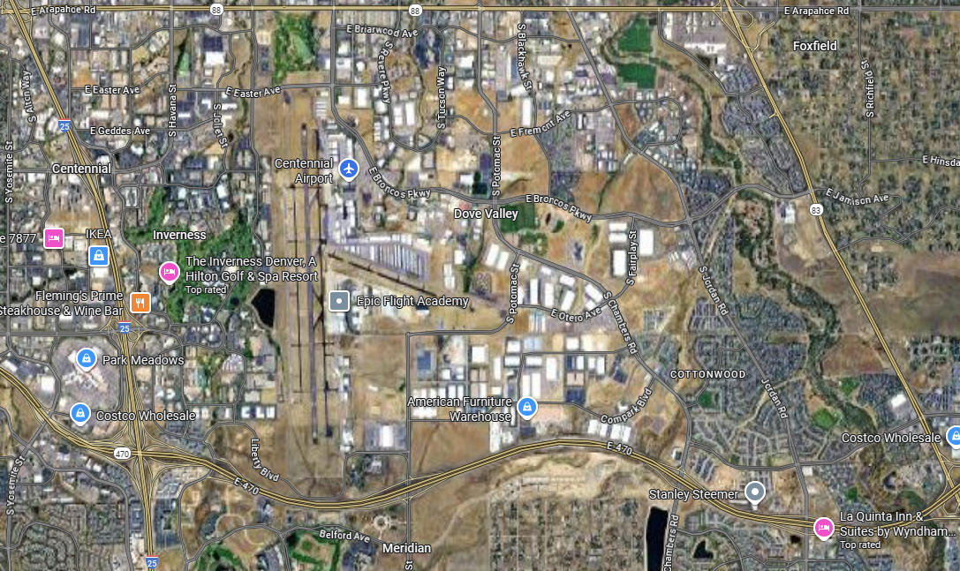
Meridian/Hilltop – build to suit
INOVA Building 3 – underway
B. INOVA Land – build to suit
Otero Warehouse – Current Logs building
Land only - Cottonwood
B
C
A
D
Notes:
Meridian – Hilltop
Inova Building 3
B. Inova Land – build to suit
Otero Warehouse – Current Logs building
Land only - Cottonwood

Slide 18
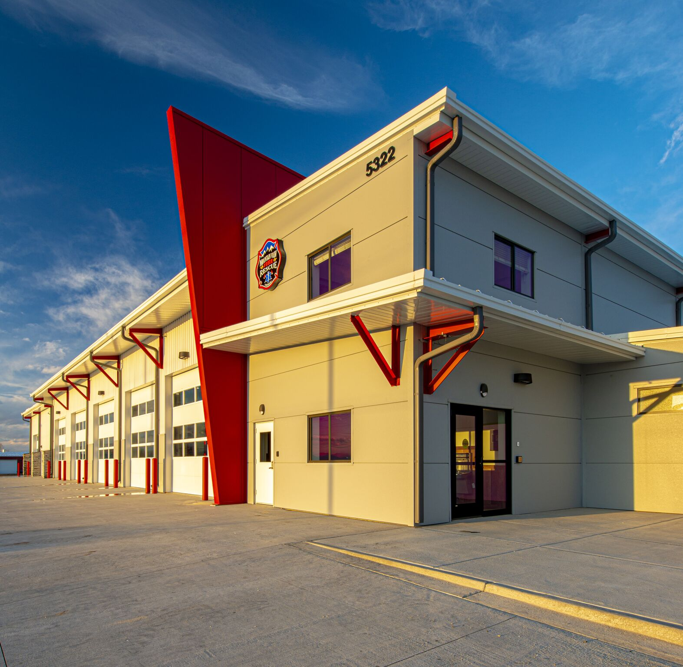
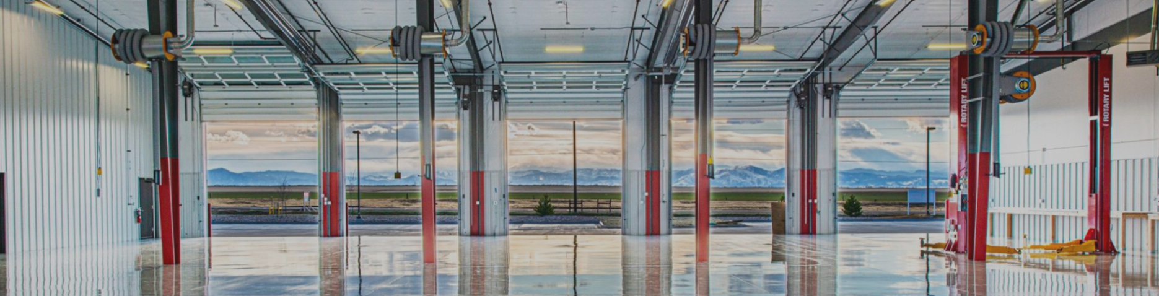
MVFPD Fleet Maintenance Facility Tour
20,700 square feet of space dedicated to five
clear-story pull-through bays and ample room for storage.
Ceiling height of 34’ to accommodate full-service maintenance with trucks on lifts with cabs.
Length of the building to accommodate a full swinging ladder truck to be fully maintained inside the bays extended.
Pump pits to test and flush trucks.

Slide 19
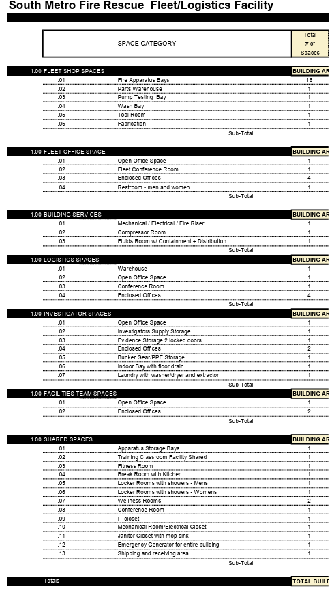
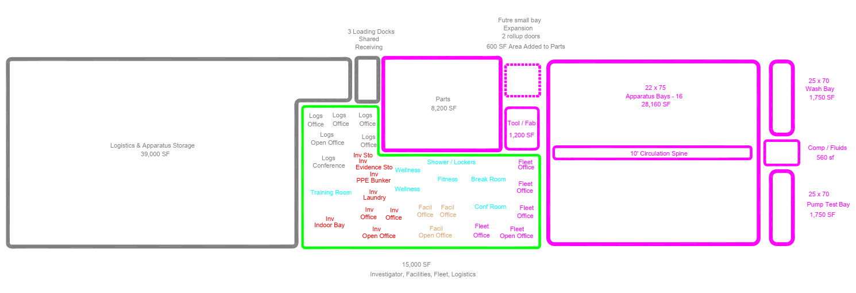
Program Analysis

Slide 20
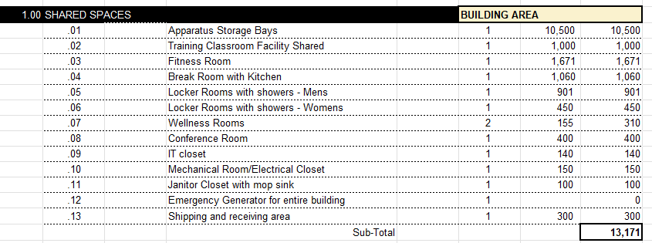
Program Analysis
FLEET – Not Adequate for Future Growth
Logistics – Leased Facility
Facilities – Quartermaster Closed Fire Station
Investigators – Currently in Station 35 & Mineral
The common shared spaces of all users adds to efficiency of the final Plan.

Slide 21


Next Steps Fleet/LOGS
Work toward a Presentation to the Board on Proposals
Work toward Evaluation Priorities
  Location
  Pricing
  Fee structure
  Schedule
Notes:
Awaiting deal sheet from the other developer. Will present both options for consideration and understanding.

Slide 22


Questions?

